Slide 1

Analyzing NYPD Historic Complaint Data

Slide 2

Introduction
This presentation explores historic complaint data reported to the NYPD from 2006 to 2020, provided by NYC Open Data. The dataset includes details such as complaint type, location, date, and demographic information. It helps identify crime patterns and trends across New York City, supporting transparency and informed decision-making for policymakers, researchers, and the public.
By analyzing this data, we can uncover insights into how crime has changed over time. It also highlights areas that may need increased attention or resources for public safety.

Slide 3
Dataset
Link: https://data.cityofnewyork.us/Public-Safety/NYPD-Complaint-Data-Historic/qgea-i56i/about_data
The NYPD Complaint Data Historic dataset contains over 7 million rows, covering reported crimes from 2006 to 2019. Each row includes details such as complaint number, offense type, location (borough, precinct, coordinates), date/time of incident, and suspect/victim demographics. This structured data helps track crime trends across time and geography in New York City.

Slide 4

ML Models used:
Based on your notebook, here's a short, polished summary in the same style:
In our analysis, We used KNN, Random Forest, and XGBoost models to classify NYPD crime complaints, with preprocessing steps like missing value handling, encoding, and feature scaling. EDA and visualizations using pandas, NumPy, seaborn, and matplotlib helped reveal key crime patterns. This project offers valuable insights for public safety agencies and urban planners to better understand and address crime in New York City.

Slide 5
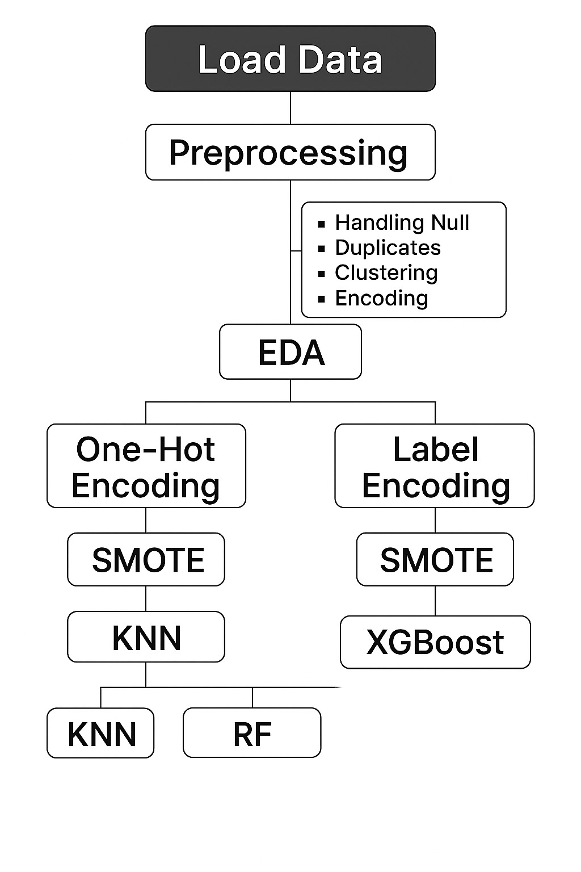
Flow Diagram

Slide 6
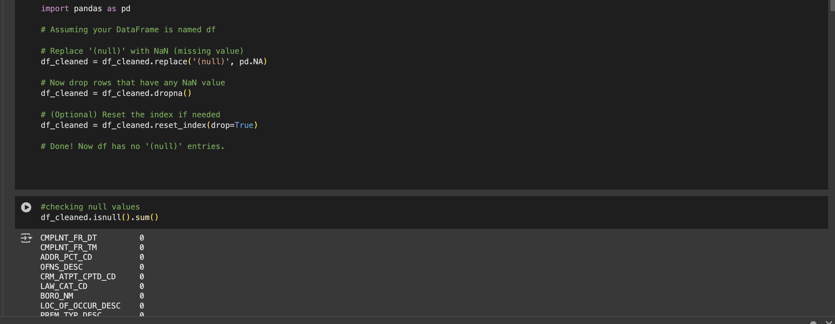
EDA – Removing null and missing values

Slide 7
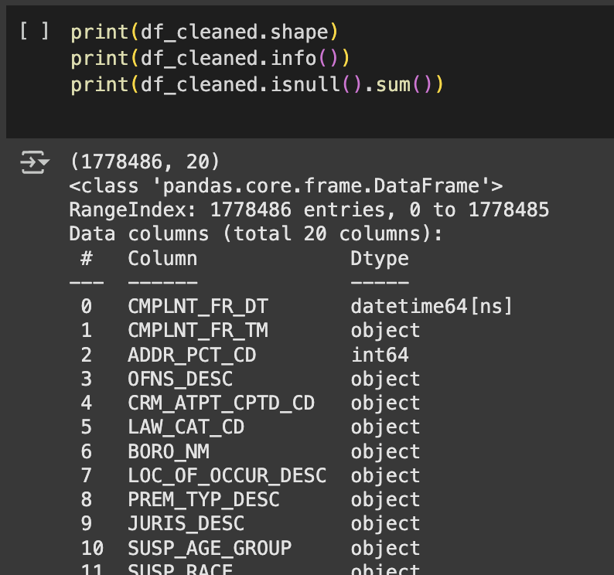
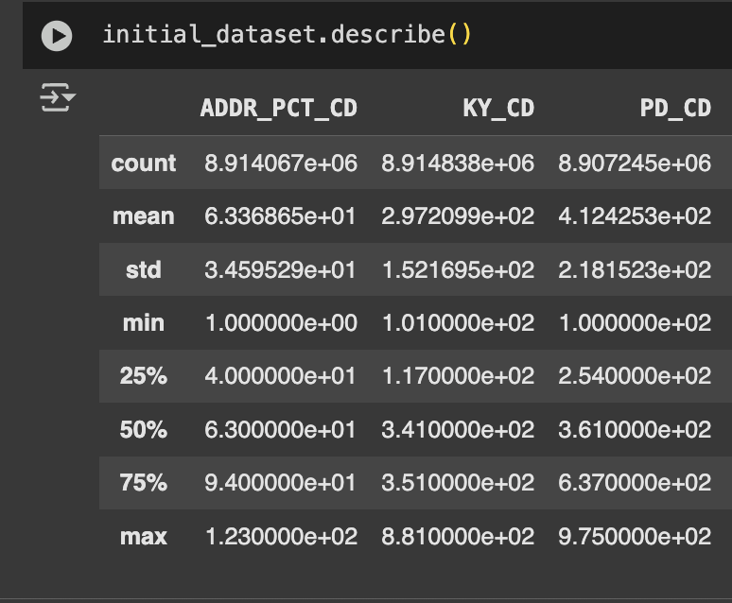
Exploratory Data Analysis

Slide 8
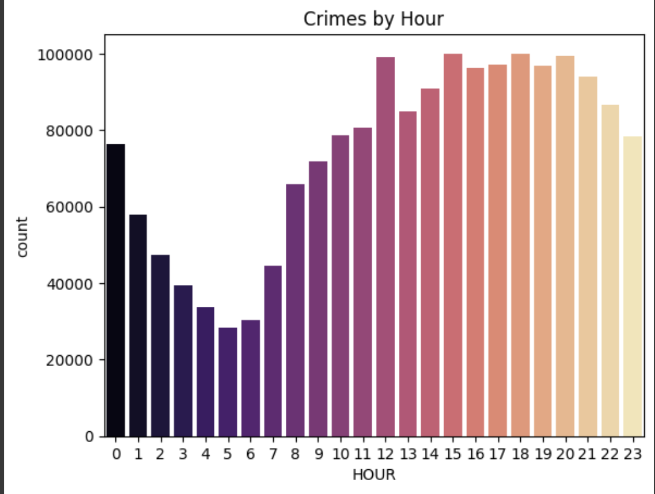
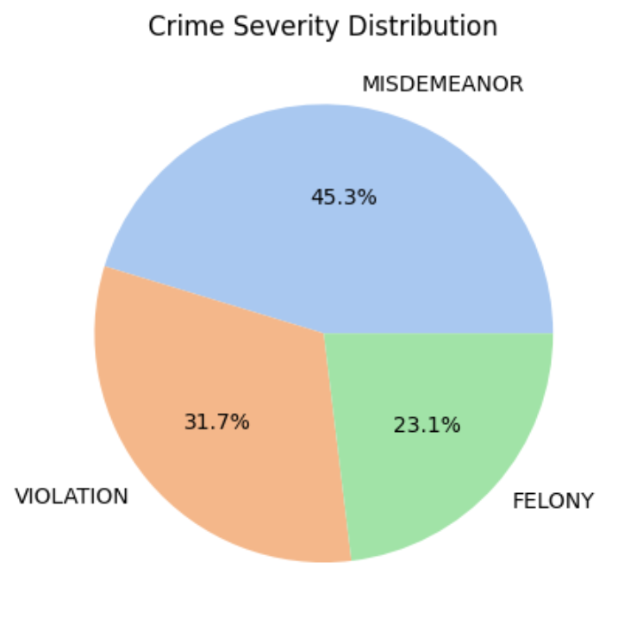
Visualizations

Slide 9
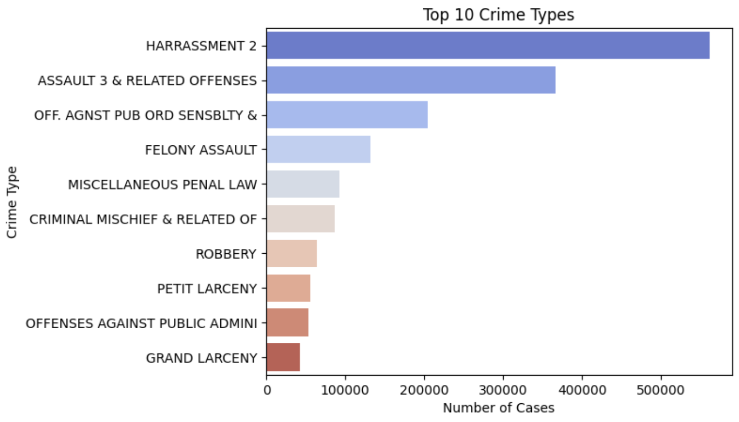
Visualizations

Slide 10
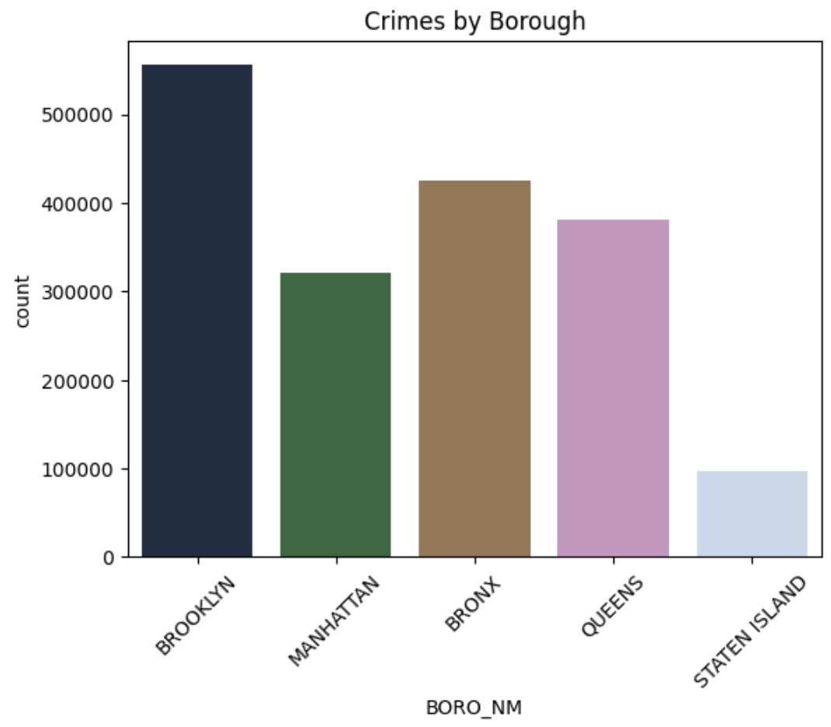
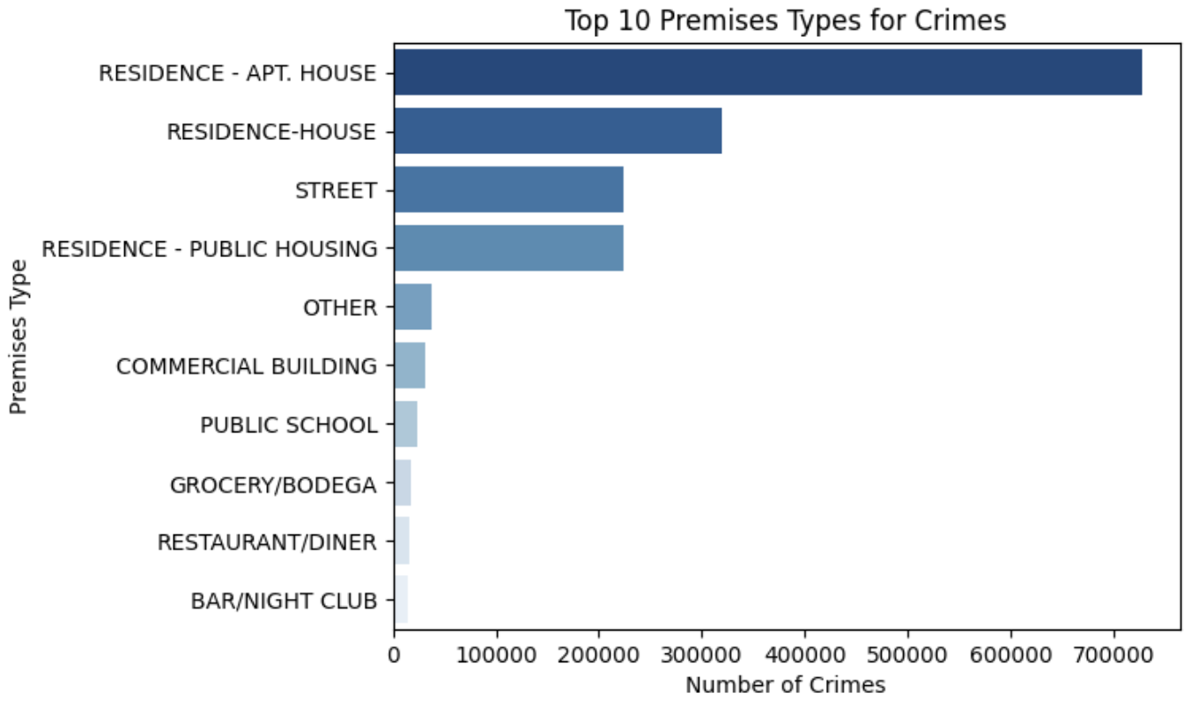
Visualizations

Slide 11
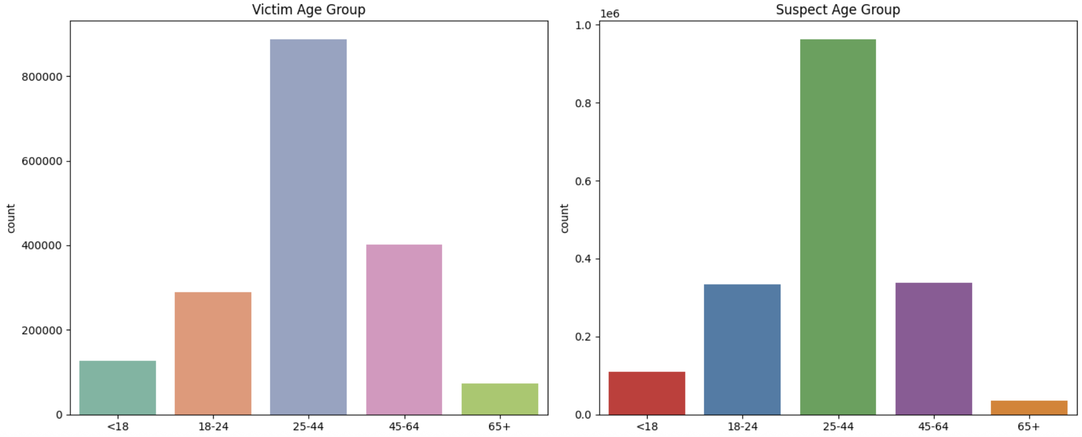
Visualizations

Slide 12
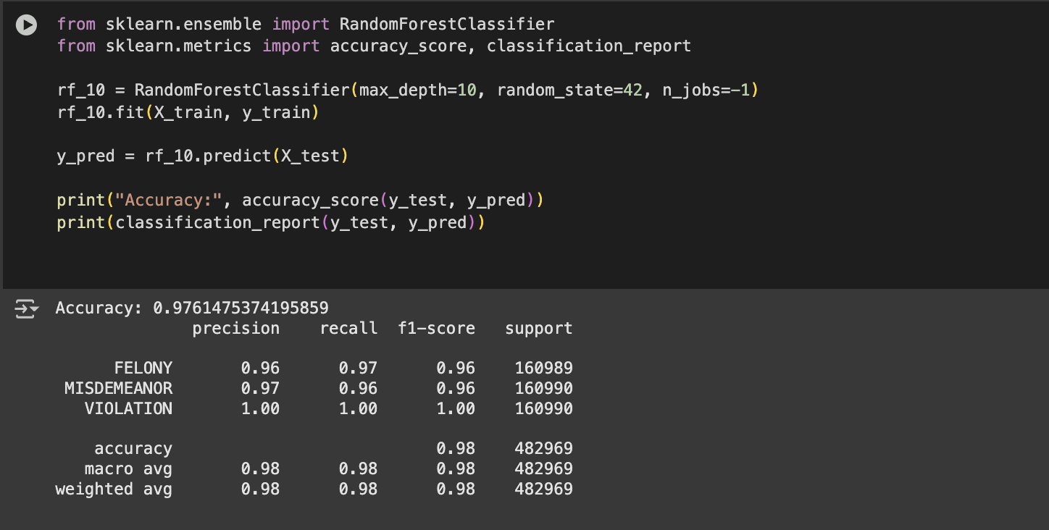
Random Forest

Slide 13
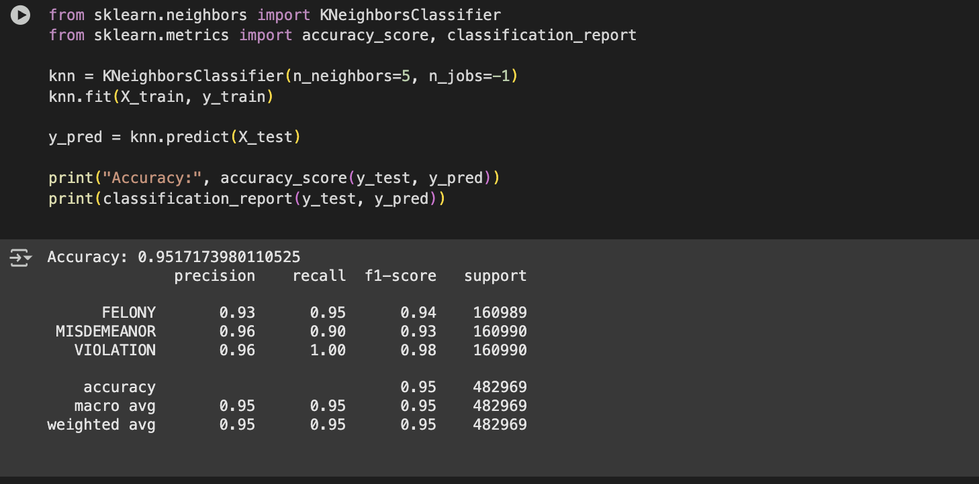
KNN

Slide 14
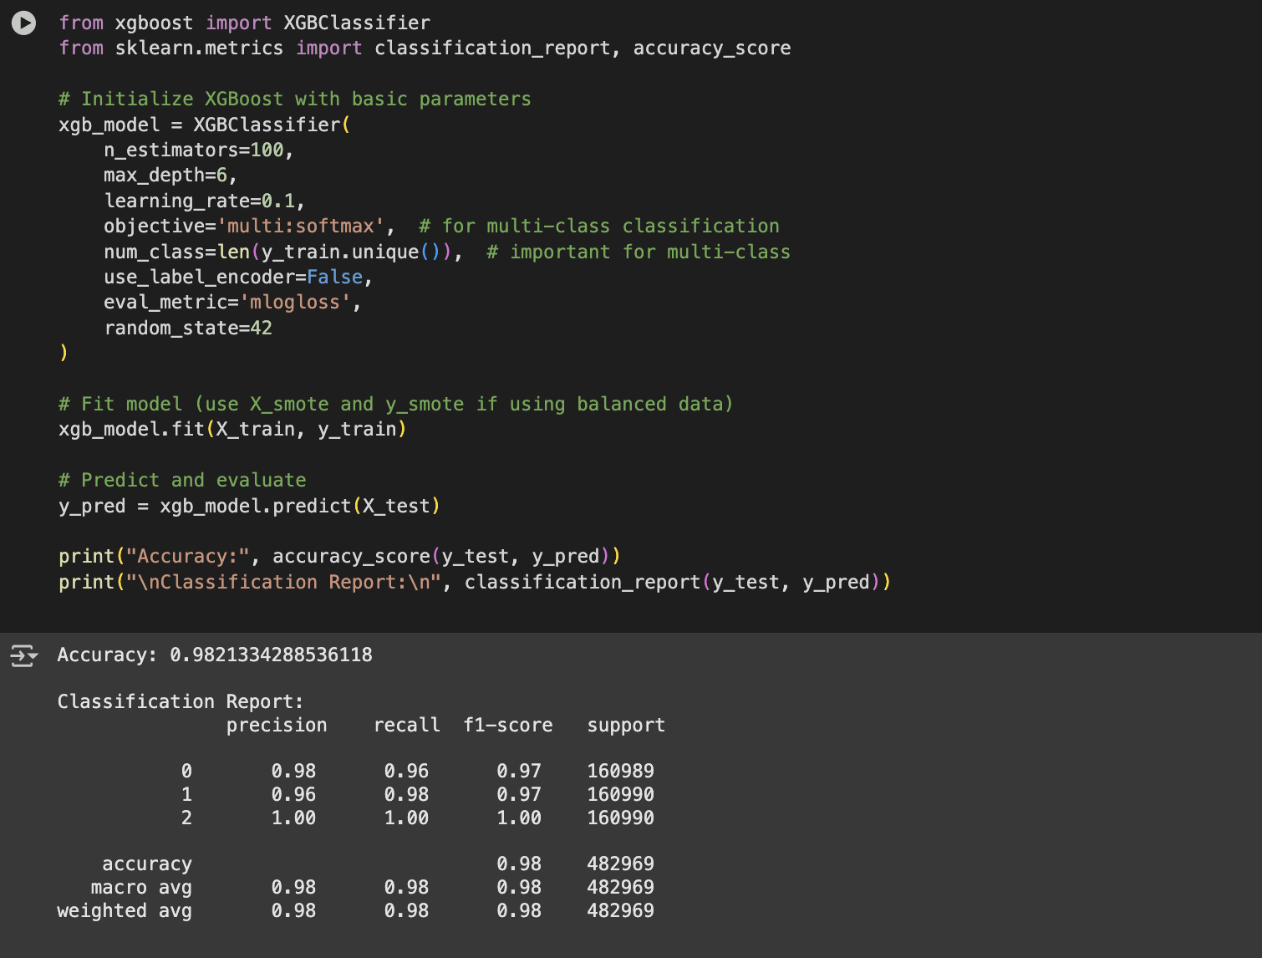
XGBoost Model

Slide 15
Comparison
Model | Accuracy | Precision | Recall | F1-Score
Random Forest | 0.9761 | 0.98 | 0.98 | 0.98
KNN | 0.9517 | 0.95 | 0.95 | 0.95
XGBoost | 0.9821 | 0.98 | 0.98 | 0.98

Slide 16
Results & Analysis
In this project, we applied three machine learning models — Random Forest, XGBoost, and K-Nearest Neighbors (KNN) — to classify crime categories based on NYPD data. After evaluating each model using accuracy, precision, recall, and F1-score, XGBoost emerged as the best performer with an accuracy of 98.21%.
This high performance is due to XGBoost’s ability to handle complex patterns and optimize classification through boosting techniques.

Slide 17

Conclusion
We analyzed NYPD crime data to uncover trends in offense types and time patterns, with 2018 showing the highest crime rate. The most common crimes in the dataset are Grand Larceny, Felony Assault, Petit Larceny, Robbery, and Burglary, with Grand Larceny being the most frequent. These highlight major focus areas for crime prevention.
Using machine learning models — KNN, Random Forest, and XGBoost — we classified crimes effectively. XGBoost performed best with 98.21% accuracy, making it ideal for predicting crime categories and aiding public safety planning.

Slide 18

Thank you

